Slide 1
Discussion on February 9th, 2023

Slide 2
Two Axis
Execution Mode
  persistent-effects
  simulation
  … (many variants)
Configuration Used (Seen)
  production set
  development set

Slide 3
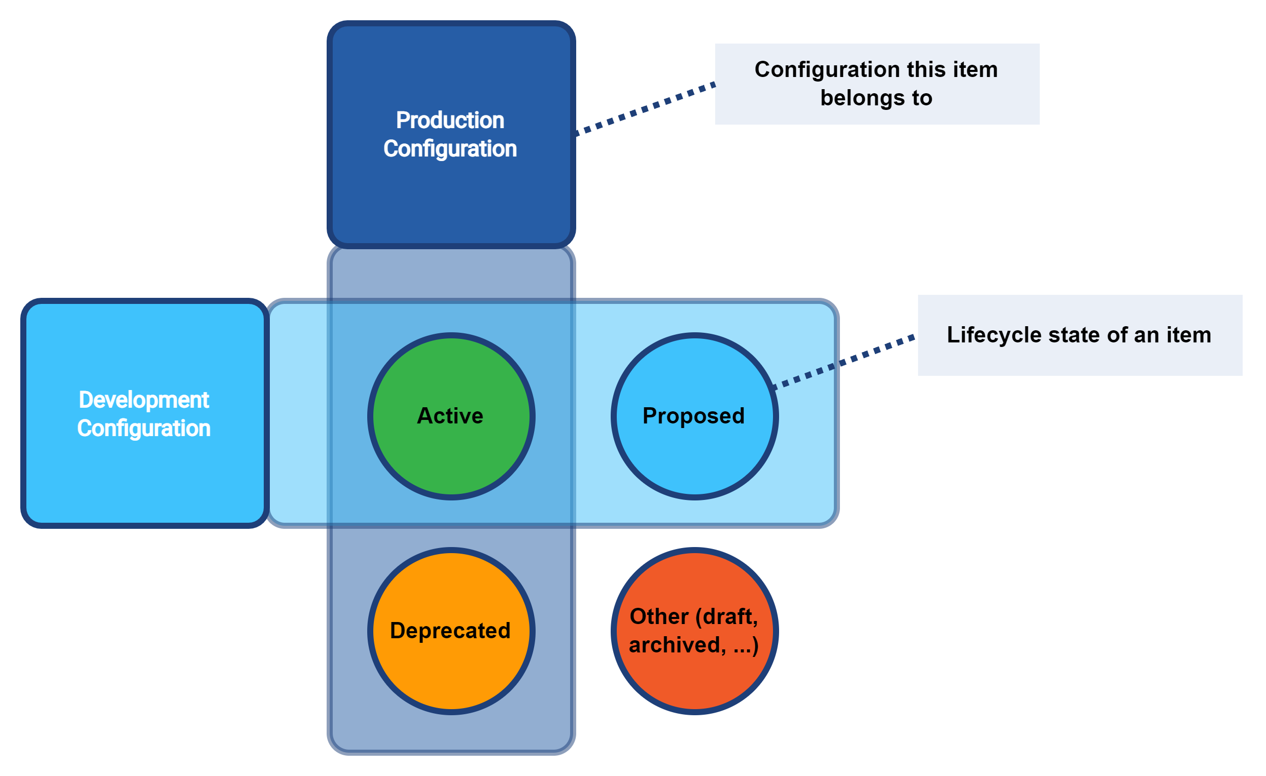
Configuration Sets

Slide 4
Execution Modes
Execution Mode | Operational data (in shadows and other objects) | Shadow classification and correlation state | All data except for “report-only” items | “Report-only” items
Simulation (shadow management) | repository | simulation | N/A | N/A
Simulation (full) | repository | repository | simulation | simulation
Persistent effects (with simulation result) | repository | repository | repository | simulation
Persistent effects (without simulation result) | repository | repository | repository | N/A

Slide 5
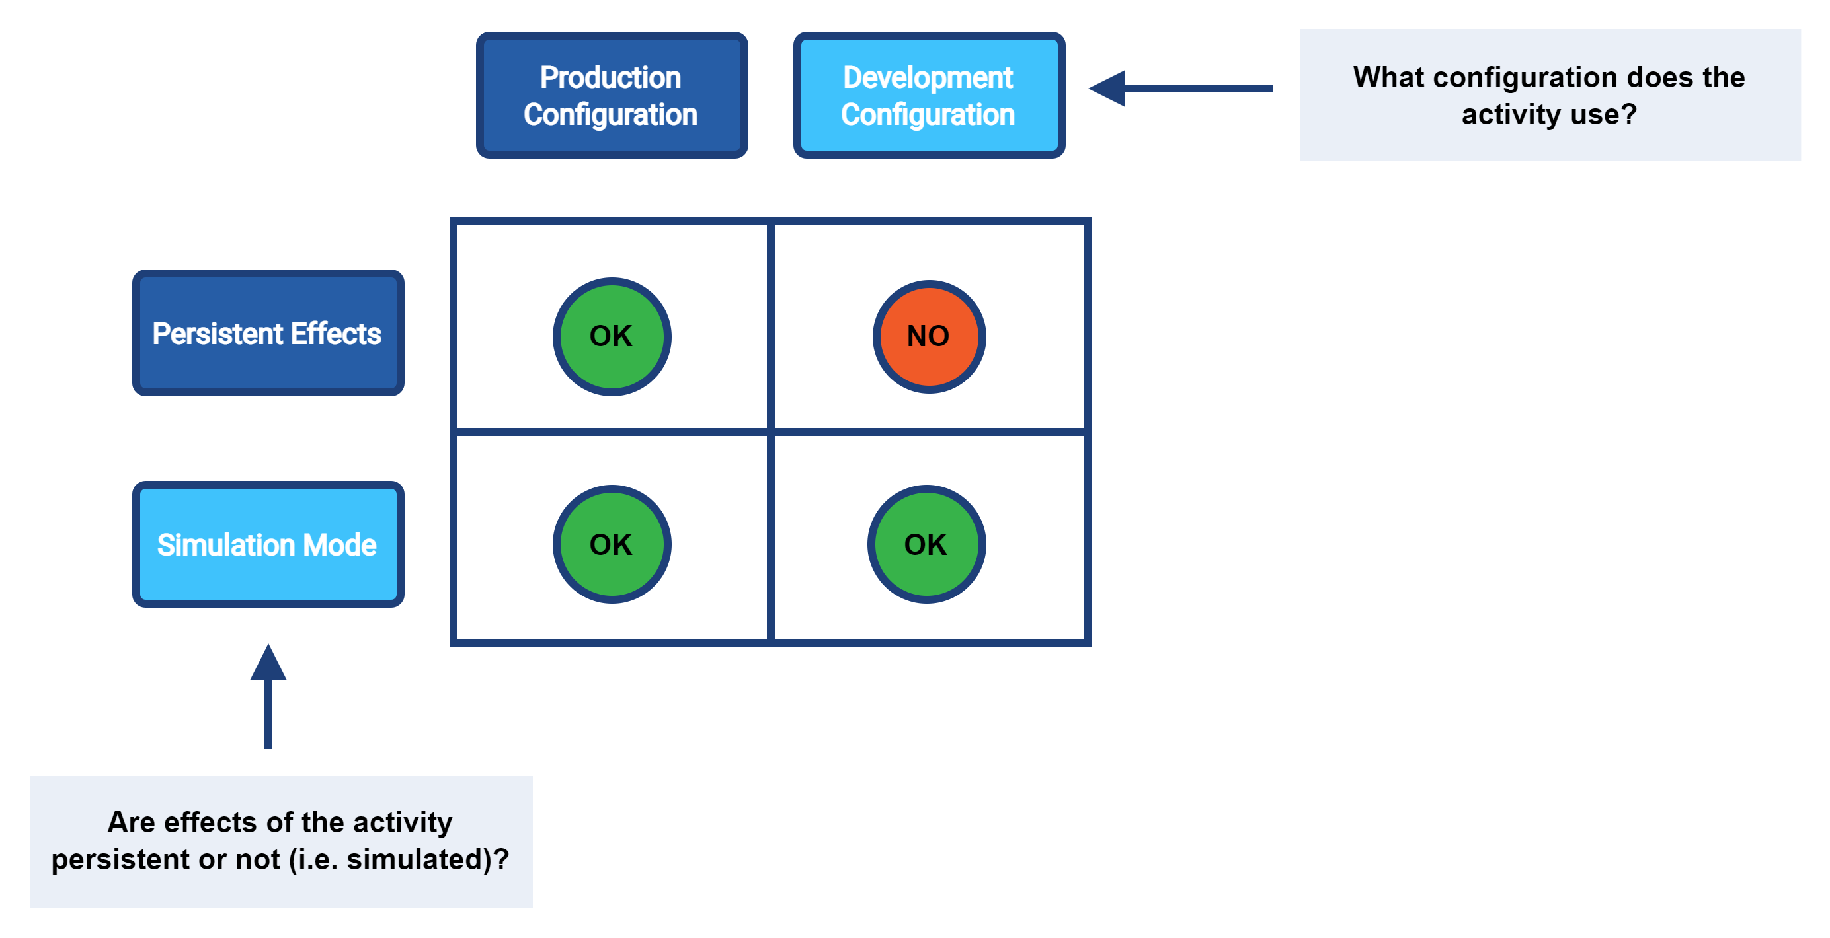
Execution Modes vs. Config Sets

Slide 6
Shadow Mgmt vs Full Simulation
Can we merge them?
Probably we can – in the future – but not now:
  too much code in model-impl takes shadows right from the repo
    we would need to deceive it with the simulated object
  repeated “get” operations – duplicate simulation records
  we don’t have a concept of “operation” – processing is done in various modules and threads (provisioning, model)
    this hurts us also in the minimalistic variant (2 records per 1 shadow)
It is safer not to mix them: i.e. simulate classification and correlation separately from “full” clockwork execution.

Slide 7
Shadow Mgmt Simulation Limitations
Main benefit: we see the deltas!
No event marks (exept for “classification updated”, “correlation updated”)
No projection context, no focus – limited custom metrics (currently none)
Up to two records per shadow (two update)

Slide 8
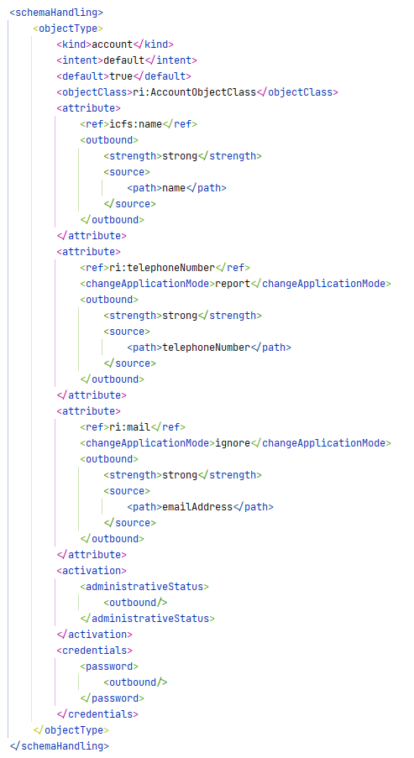
Report-Only Items
(or “simulation-only”?)
report = deltas go to simulation result
  in simulation mode it is automatic
  in “persistent effects” mode if the result is present
ignore =
  mappings nor deltas are not computed
Beware of chaining!!

Slide 9
Report-Only Items Limitations
Main benefit: we see the deltas!
Limited context in simulation result
  no focus record … but we may provide at least the focus OID
No event marks
  can be probably added but not sure about this
Dangerous (chaining)

